Slide 1
Lexical Analysis/Scanning Session 03
Course : Comp6062 – Compilation Techniques
Effective Period : September 2021

Slide 2
Learning Outcomes
At the end of this session, expected student will be able to:
Students can give the definition of lexical analysis (scanner) and its role in the compiler
Students can explain the operation of the language with a regular expression for the introduction of the token
Students can demonstrate how the introduction of the token by using the transition diagram

Slide 3
Outline Material
Function of Lexical analyzer
Description of token, pattern, lexeme and attribute
Input buffering
Symbol tables

Slide 4
Some Other Issues in Lexical Analyzer
The main task is to read input characters of the source program, group them into lexemes, and produce as output a sequence of tokens for each lexeme in the source program.
Ex: identifier newval
What is the end of a token? Is there any character which marks the end of a token?
It is normally not defined.
If the number of characters in a token is fixed, in that case no problem: + -
But < ➔ < or <> (in Pascal)
The end of an identifier : the characters cannot be in an identifier can mark the end of token.
We may need a lookahead
In Prolog: p :- X is 1. p :- X is 1.5.
The dot followed by a white space character can mark the end of a number. But if that is not the case, the dot must be treated as a part of the number.
-- n ne new newv newva newval
The lexical analyzer has to recognize the longest possible string.

Slide 5
Some Other Issues in Lexical Analyzer
Skipping comments
Normally we don’t return a comment as a token.
We skip a comment, and return the next token (which is not a comment) to the parser.
So, the comments are only processed by the lexical analyzer, and the don’t complicate the syntax of the language.
Symbol table interface
symbol table holds information about tokens (at least lexeme of identifiers)
how to implement the symbol table, and what kind of operations.
hash table – open addressing, chaining
putting into the hash table, finding the position of a token from its lexeme.
Positions of the tokens in the file (for the error handling).

Slide 6
Some Other Issues in Lexical Analyzer
Some Other Issues in Lexical Analyzer
Another task is correlating error message generated by the compiler with the source program.
Lexical analyzer can be divided into cascade of two processes:
Scanning
Lexical analysis
The reasons why lexical analysis is separated from parsing (syntax analysis)
Simplicity of design is the most important consideration.
Compiler efficiency is improved
Compiler compatibility is enhanced

Slide 7
The Role of Lexical Analyzer
Token is a pair consisting of a token name and an optional attribute value.
Token name is an abstract symbol representing a kind of lexical unit.
Token names are the input symbol that the parser processes.
Pattern is a description of the form that the lexemes of a token may take.
Lexeme is a sequence of characters in the source program that matches the pattern for a token and is identified by the lexical analyzer as an instance of that token.

Slide 8
The Role of Lexical Analyzer
Classes of Token
One token for each keyword.
Tokens for the operators, either individually or in classes such as the token comparison mention in table.
One token representing all identifiers.
One or more tokens representing constants, such as numbers and literal strings.
Tokens for each punctuation symbol, such as left and right parentheses, comma, and semicolon.

Slide 9
The Role of Lexical Analyzer
Classes of Token
Token | Informal Description | Sample Lexemes
if | characters i,f | if
else | characters e, l, s, e | else
comparison | < or > or <= or >= or == or != | <=, !=
id | letters followed by letters and digits | pi, score, D2
number | any numeric constant | 3.14159, 0, 6.02e23
literal | anything but “, surrounded by “’s | “core dumped”

Slide 10
The Role of Lexical Analyzer Token
Token represents a set of strings described by a pattern.
Identifier represents a set of strings which start with a letter continues with letters and digits
The actual string (newval) is called as lexeme.
Tokens: identifier, number, addop, delimeter, …
Since a token can represent more than one lexeme, additional information should be held for that specific lexeme. This additional information is called as the attribute of the token.
For simplicity, a token may have a single attribute which holds the required information for that token.
For identifiers, this attribute a pointer to the symbol table, and the symbol table holds the actual attributes for that token.

Slide 11
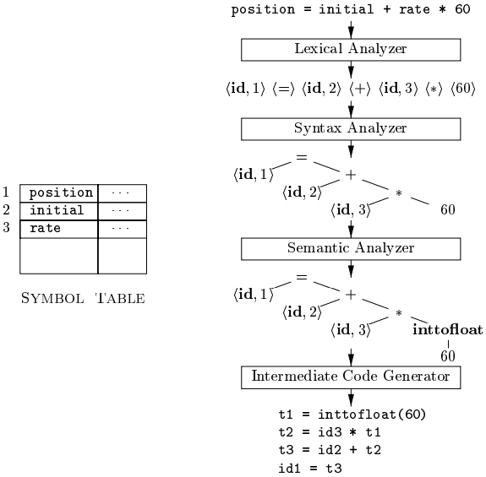
The Role of Lexical Analyzer Token
Some attributes:
<id,attr> where attr is pointer to the symbol table
<assgop,_> no attribute is needed (if there is only one assignment operator)
<num,val> where val is the actual value of the number.
Token type and its attribute uniquely identifies a lexeme.
Regular expressions are widely used to specify patterns.
Example: Token name id has attribute value of a pointer to the symbol table for that identifier.

Slide 12
The Role of Lexical Analyzer
Lexical errors
It is hard for a lexical analyzer to tell that there is a source-code error.
Example: fi ( a == f(x) ) …
The simplest recovery strategy is “panic mode” recovery.
Other possible error-recovery actions are:
Delete one character from the remaining input
Insert a missing character from the remaining input
Replace a character by another character
Transpose two adjacent characters

Slide 13
Input Buffering
We cannot be sure we’ve seen the end of an identifier until we see a character that is not a letter of a digit.
In C, single-character operators like -, =, or < could also be the beginning of a two-character operator like ->, ==, or <=.
First, we can use two-buffer scheme that handles large lookaheads.
We then can consider using “sentinels”.

Slide 14
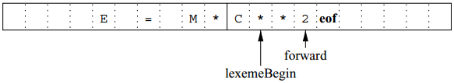

Input Buffering
Buffer pairs
Two pointers to the input are maintained:
Pointer lexemeBegin.
Pointer forward.

Slide 15
Lexical Analyzer
Lexical Analyzer reads the source program character by character to produce tokens.
Normally a lexical analyzer doesn’t return a list of tokens at one shot, it returns a token when the parser asks a token from it.
token
Parser
Lexical
Analyzer
source
program
get next token

Slide 16
Regular Expressions
Regular expressions (RE) used to describe tokens of a programming language. An RE is built up of simpler regular expressions (using defining rules)
Each regular expression denotes a language. A language denoted by a regular expression is called as a regular set.

Slide 17
Regular Definitions
To write regular expression for some languages can be difficult, because their regular expressions can be quite complex. In those cases, we may use regular definitions.
We can give names to regular expressions, and we can use these names as symbols to define other regular expressions.
A regular definition is a sequence of the definitions of the form:
d₁ → r₁ where d_{i} is a distinct name and
d₂ → r₂ r_{i} is a regular expression over symbols in
Σ ∪ {d₁,d₂,...,d_{i-1}}
d_{n} → r_{n}
basic symbols previously defined names

Slide 18
Regular Definitions
Ex: Identifiers in Pascal
id → letter (letter | digit ) *
letter → A | B | ... | Z | a | b | ... | z
digit → 0 | 1 | ... | 9
If we try to write the regular expression representing identifiers without using regular definitions, that regular expression will be complex. (A|...|Z|a|...|z) ( (A|...|Z|a|...|z) | (0|...|9) )*
Ex: Unsigned numbers in Pascal/Delphie
unsigned-num → digits opt-fraction opt-exponent
digit → 0 | 1 | ... | 9
digits → digit⁺
opt-fraction → ( . digits ) ?
opt-exponent → ( E (+|-)? digits ) ?

Slide 19
Finite Automata
A recognizer for a language is a program that takes a string x, and answers “yes” if x is a sentence of that language, and “no” otherwise.
We call the recognizer of the tokens as a finite automaton.
A finite automaton can be: deterministic(DFA) or non-deterministic (NFA)
This means that we may use a deterministic or non-deterministic automaton as a lexical analyzer.
Both deterministic and non-deterministic finite automaton recognize regular sets.
Bina Nusantara University
19

Slide 20
Finite Automata
Which one?
deterministic – faster recognizer, but it may take more space
non-deterministic – slower, but it may take less space
Deterministic automatons are widely used lexical analyzers.
First, we define regular expressions for tokens; Then we convert them into a DFA to get a lexical analyzer for our tokens.
Algorithm1: Regular Expression ➔ NFA ➔ DFA (two steps: first to NFA, then to DFA)
Algorithm2: Regular Expression ➔ DFA (directly convert a regular expression into a DFA)
Bina Nusantara University
20

Slide 21
Deterministic Finite Automaton (DFA)
Deterministic Finite Automaton – (DFA)
Mathematics model
Input Output Discrete
Configuration internal is called “State”
Transition betwen state on input symbol
Only one trasition of one state with a specifics input symbol (deterministic)
Directed Graph describes the FA called "Transition Diagram"

Slide 22
Non-Deterministic Finite Automaton (NFA)
A non-deterministic finite automaton (NFA) is a mathematical model that consists of:
S - a set of states
Σ - a set of input symbols (alphabet)
move – a transition function move to map state-symbol pairs to sets of states.
s₀ - a start (initial) state
F – a set of accepting states (final states)

Slide 23
Non-Deterministic Finite Automaton (NFA)
ε- transitions are allowed in NFAs. In other words, we can move from one state to another one without consuming any symbol.
A NFA accepts a string x, if and only if there is a path from the starting state to one of accepting states such that edge labels along this path spell out x.

Slide 24
References
Aho, A.V., Ravi, S., & Ullman, J.D. (2007). Compiler : Principle, techniques and tools. 2nd. Addison-Wesley. New York. ISBN : 0321491696, Chapter 3.1 – 3.5 (page 109-146)
http://dragonbook.stanford.edu/lecture-notes/Stanford-CS143/03-Lexical-Analysis.pdf

